Slide 1

Welcome to Nukissiorfiit
For our distinguished guests from the Icelandic trade delegation
chaired by Icelands Minister of Finance Mr. Bjarni Benediktsson
The National Utility Company of Greenland

Slide 2
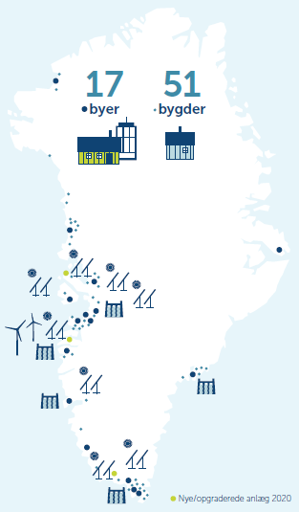

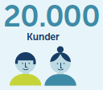
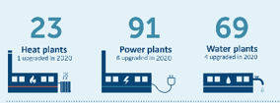
Introduction to Nukissiorfiit
Nukissiorfiit supplies electricity, water and heat throughout Greenland
Utility company responsible for the production and distribution of electricity, water and heat (excluding airports)
Supplies approx. 20,000 customers in 17 cities and 52 settlements
Net-managed company, owned by the Greenland
Refers to the Ministry of Agriculture, Self-Supply, Energy and Environment
Notes:
No power grid infrastructure.
Island operation every town and settlement.
High demands to back up facilities.

Slide 3
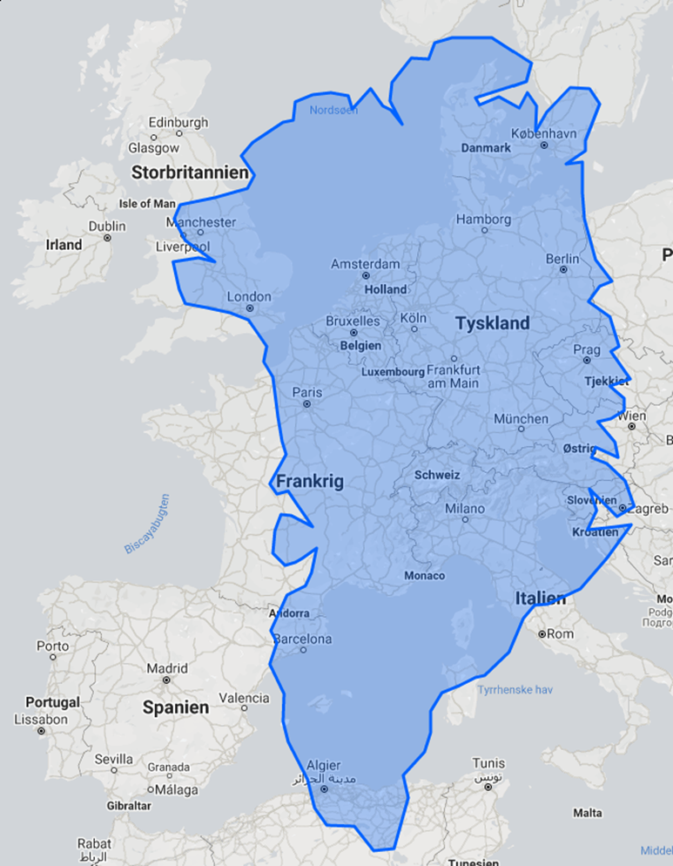

Slide 4

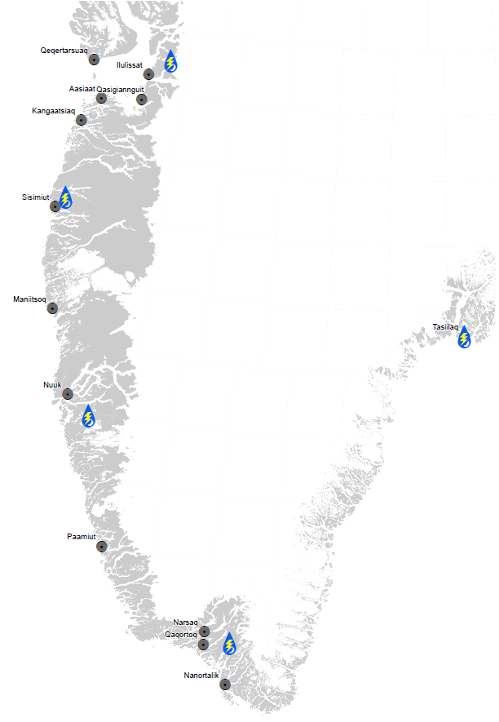
Present and near future hydropower plants
Name | City | Year | Capacity (MW) | Price (€ mio.), 2017-priser
Buksefjorden | Nuuk | 1993, 2008 | 45
Tasiilaq | Tasiilaq | 2004 | 1,2 | 11,4
Qorlortorsuaq | Narsaq, Qaqortoq | 2008 | 7,6 | 54
Sisimiut | Sisimiut | 2010 | 15 | 80
Paakitsoq | Ilulissat | 2013 | 22,5 | 90
100
295
232
Qasigiannguit & Aasiaat | Qasigiannguit & Aasiaat | 2024/2026 | 15 -22 | 149

Slide 5
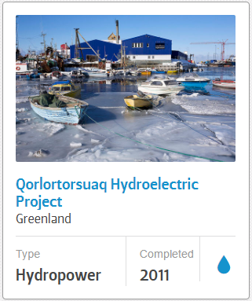
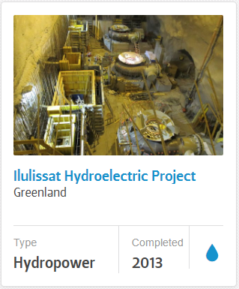

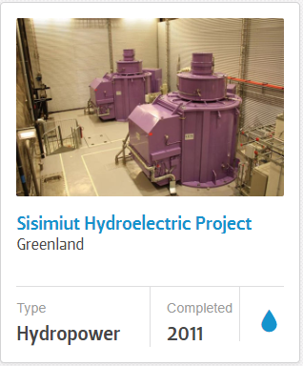
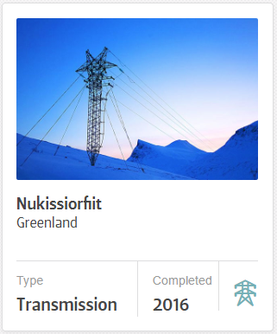

Long history of Icelandic-Greenlandic collaboration

Slide 6


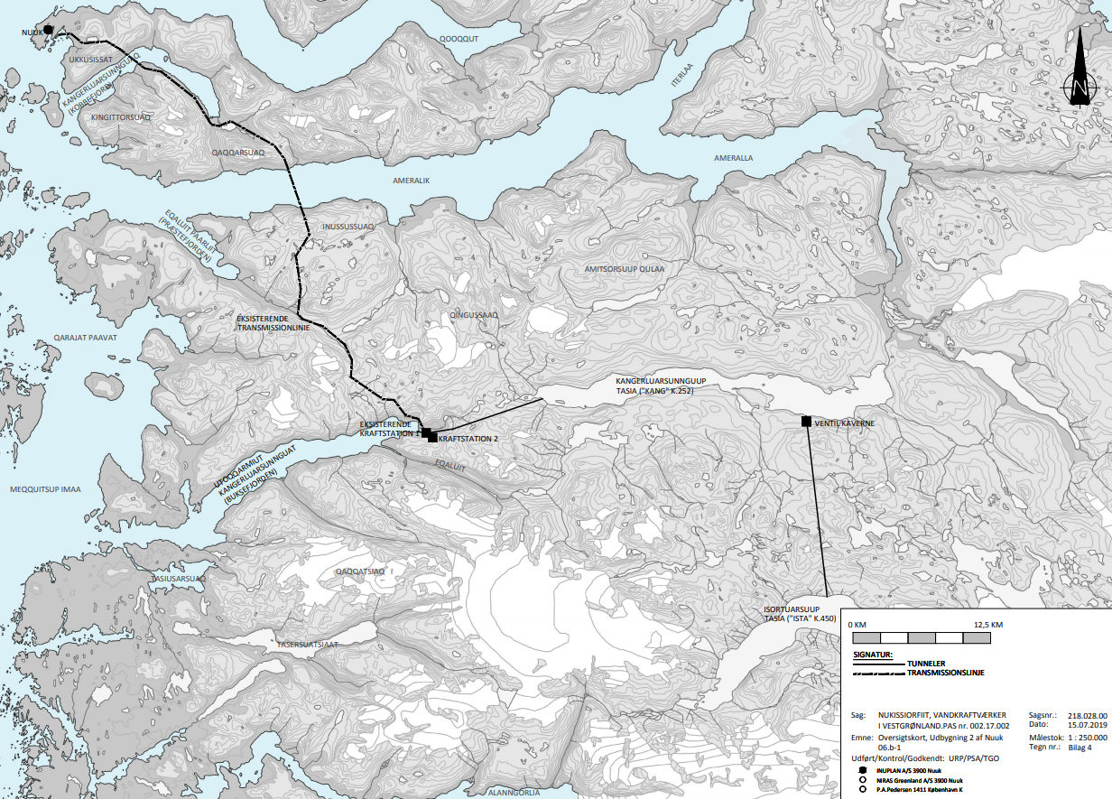
Buksefjorden hydropower expansion
Tentative Timeframe Nuuk
Environmental investigations/ ToR | 2021
Geological survey additional Hydrology Environmental permit | 2022
Finish specifications Tender material Prequalification Entrepreneur site visit Tender | 2023
Contract Establishing site camp Start constructing | 2024
Finished construction | 2026
Hydropower, Buksefjorden expansion For Nuuk
Installed effect + expansion | 45 + 55 MW
Energy production + expansion | 225 → 660 GWh/year
Profitability | High
Energy demand | 384 GWh/year
Power Heating Transportation | 83 GWh/year 318 GWh/year 46 GWh/year
Current cost savings diesel @ 4,55 DKK/L | ~ 19,25 mill. DKK
CO₂ saved yearly | ~ 52.000 tons
Notes:
Adopted plans for expansion 45 to 100 MW.

Slide 7
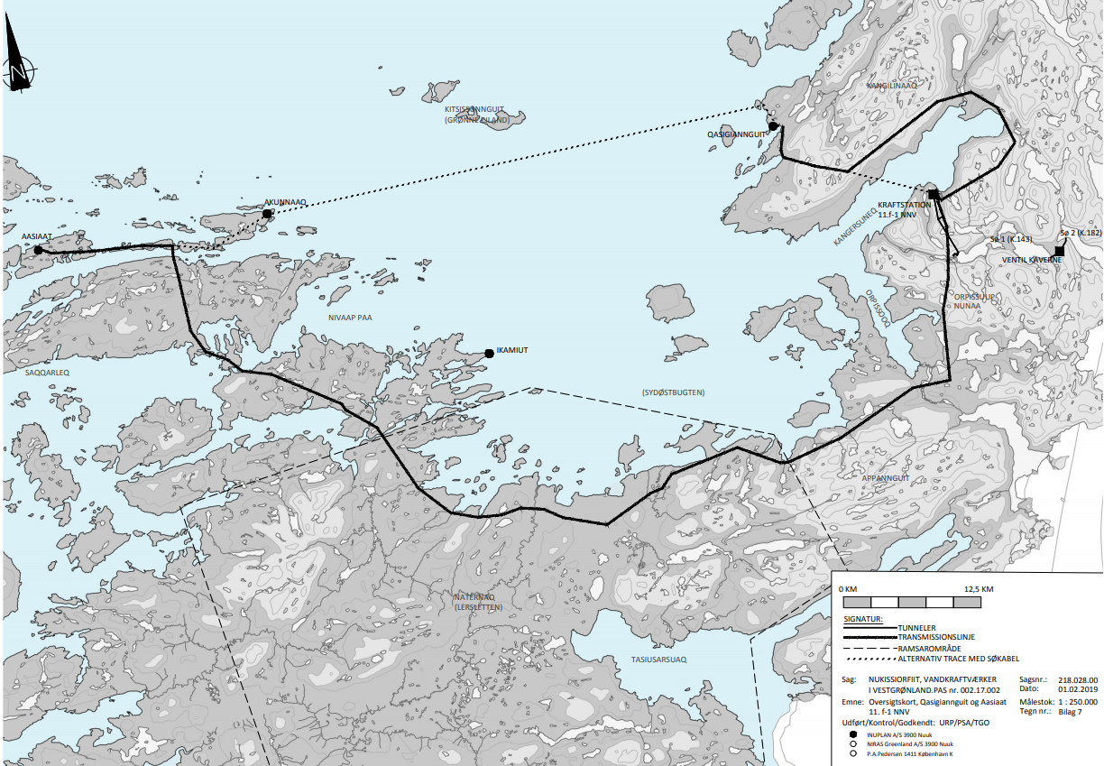
Qasigiannguit & Aasiaat, new hydropower plant
Tentative Timeframe Aas-Qas
Enviromental investigations/ ToR | 2022
Environmental permit | 2023
Geological survey additional Hydrology | 2024
Finish specifications Tender material Prequalification Entrepreneur site visit Tender | 2025
Contract Establishing site camp Start constructing | 2026
Finished construction | 2028
Hydropower, Qasigiannguit, New HPP
Installed effect | 15,0 – 22 MW
Energy production | 94 GWh/year
Profitability | Medium
Energy demand | 50- 56 GWh/year
Power Heating Transportation | 19 GWh/year 64-126 GWh/year 11 GWh/year
Cost saving diesel @ 4,55 DKK/L | ~ 34 mill. DKK
CO₂ saved yearly | ~ 31.500 tons

Slide 8
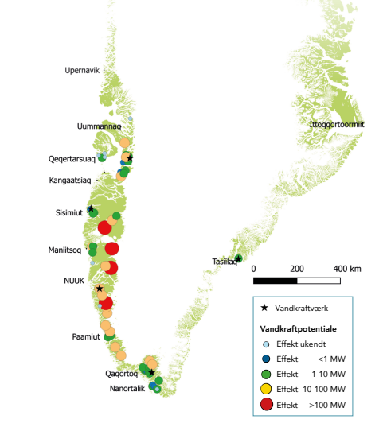
Utilization of Greenland's hydropower potentials
Greenland has quite large untapped hydropower potentials, which due to our size and the location of the cities are not exploited
Greenlandic hydropower is among the cheapest forms of energy in the world, but requires large one-off investments
Greenlandic hydropower can be interesting for industrial use, such as data centers, aluminum production and Power-to-X - a technology that is developing rapidly now
Notes:
Udnyttelse

Slide 9

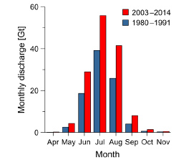
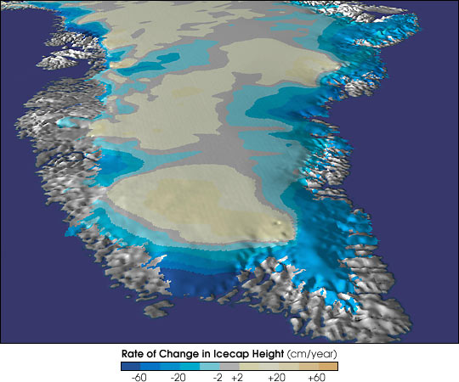
The hydropower potentials are growing
The ice sheet contains the largest freshwater resource in the northern hemisphere
The inland ice ensures a stable supply of meltwater to potential hydropower reservoir lakes
Studies from GEUS indicate an increase in melting from the ice sheet of 54% from the period 1980-1991 to the period 2003-2014 in southwest Greenland
Recent studies from GEUS show a continued increase in melting
This helps to increase the hydropower potential and thus Greenland's potential as a home for sustainable energy-intensive industry that can be supplied with clean and cheap energy.
Notes:
Opdater**

Slide 10
Greenland's hydropower resources
Notes:
Figur 6. Middelhydrografer for afstrømningen fra den isdækkede del af oplandet til Tasersiaq for henholdsvis perioden 1975-2002 (blå) og perioden 2003-2014 (rød). Forskellen mellem de to er tegnet ind som en sort kurve. Den første periode er baseret på observationer fra i gennemsnit ca. 20 år, den anden periode fra i gennemsnit ca. 10 år.
Siden dengang er der observeret en øget nedbør og afsmeltning fra indlandsisen. Reelt vil flere af de beskrevne potentialer være større, og variationen fra år til år vil også være mere ekstrem

Slide 11
Industrial potentials over 300 GWh
Potentiale | Name | Capacity | Status
03.h | Johan Dahl Land | 300 GWh | Historic data
05.h | Killeqarfik | 310-625 GWh | -
05.j | Isorsua | 340-850 GWh | -
05.k | Kangaarsuup tasersua | 500-1000 GWh | -
06.b-1 | Buksefjord 2 | +320 GWh | Outline Proposal (2020)
06.b-2 | Buksefjord 3 | +430 GWh | Aktiv data collection
06.c | Allumersat | 300-700 GWh | Aktiv data collection
06.d | Qaqqat Akuleriit | 300-500 GWh | Aktiv data collection
06.e | Kangerluarsussuaq | 900-1300 GWh | Aktiv data collection
06.g | Imarsuup Isua | 1480 GWh | Aktiv data collection
06.h | Tasersuup Isua | 500 GWh | Aktiv data collection
07.d | Søndre Isortup Isua | 1000 GWh | Aktiv data collection
07.e | Tasersiaq | 2500 GWh | Aktiv data collection
07.f | Umiiviit | 900 GWh | Historic data
12.j | Nuussuaq | 350 GWh | -
Sum |  | ~11.600 GWh
Notes:
Oplysningerne om potentialernes størrelse stammer primært I den dokumentation der beskriver de enkelte potentialer

Slide 12
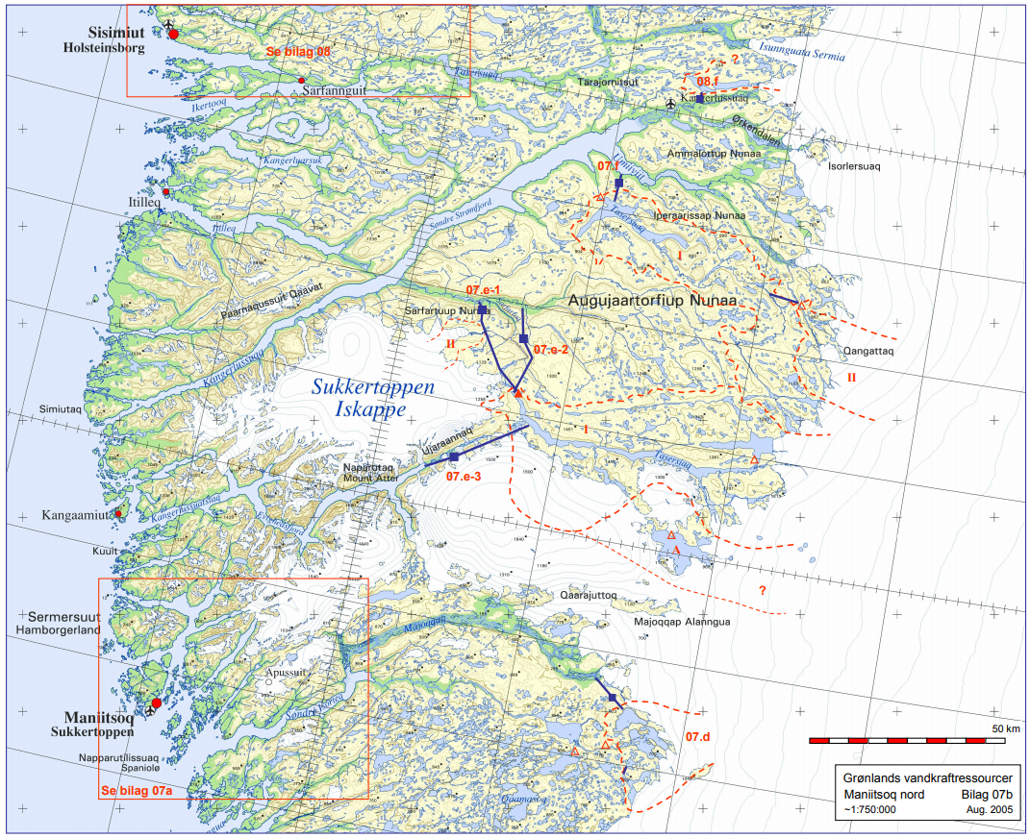

Maniitsoq potentials
Tender in 2022/23
07.f Umiiviit 900 – 1350 GWh
07.e Tasersiaq 2500 - 3750 GWh
07.d Søndre Isortup Isua 1000 - 1500 GWh

Slide 13
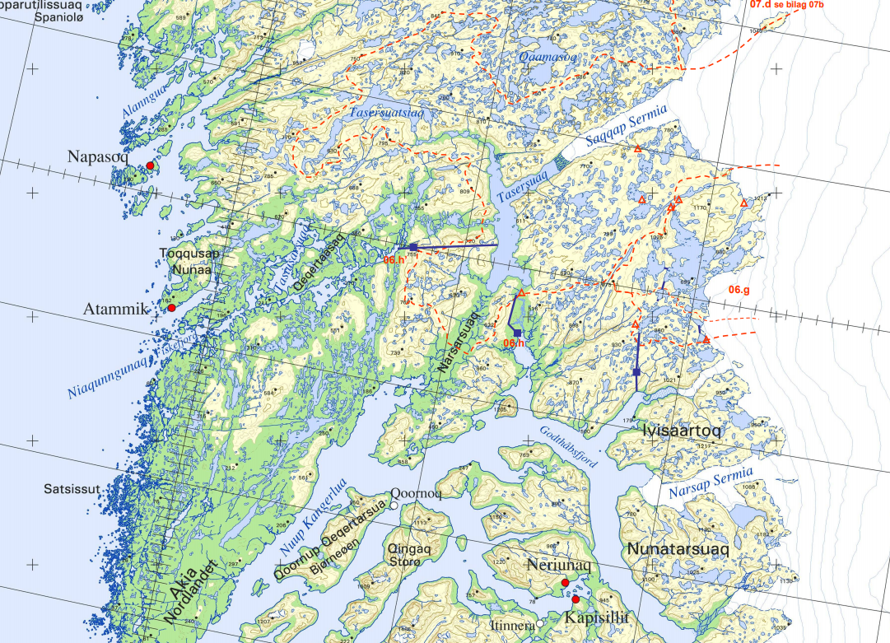
The Nuuk fjord potentials
Tender in 2022/23
06.h Tasersuup Isua 500 - 750 GWh
06.g Imarsuup Isua 1480 - 2220 GWh

Slide 14
Cluster potential
Combining the 5 potentials
8.000 – 10.000 GWh and growing
2 GW cluster plant @ 60% capacity factor
3 billion EUR estimate on power generation and transmission
  300 km transmission lines,
  no fjord or glacier crossings, no sub sea cables.
LCOE – around
  10 USD / MWh
  8 EUR / MWh
.
Technology | LCOE USD/MWh Median | LCOE USD/MWh Lowest
Coal | 73 – 86 | 70
Wind offshore | 59 – 85 | 37
Solar | 31 - 63 | 24
Wind onshore | 30 – 49 | 22
Hydro +5MW reservoir | 26 - 57 | 20
Source: https://www.iea.org/reports/projected-costs-of-generating-electricity-2020
Notes:
levelized cost of energy

Slide 15

The map again of sites with unexpolited hydropower potentials
The hydropower Expertise
Licensing authority

Slide 16
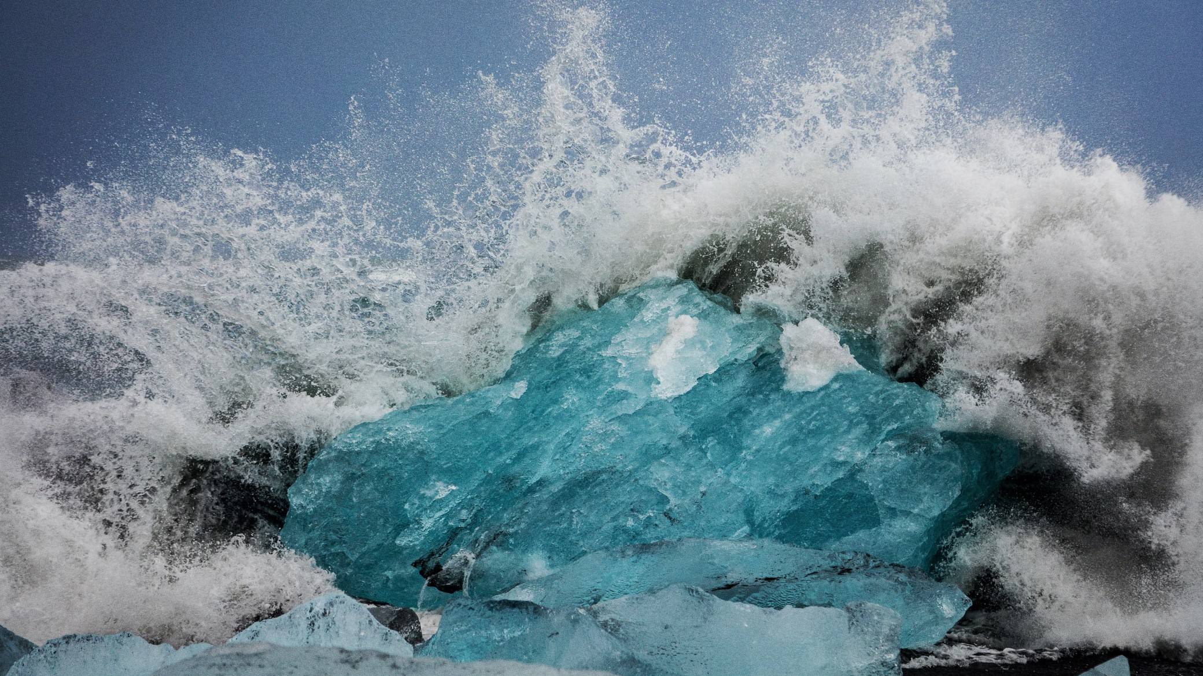
Qujanaq

